Slide 1
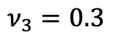
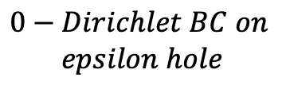
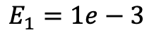
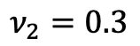
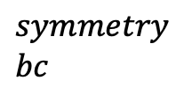
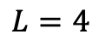
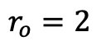
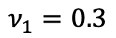
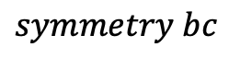
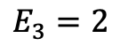
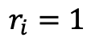
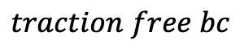
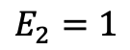
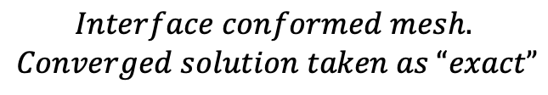
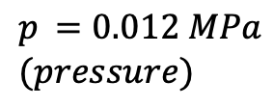
$$traction free bc$$
$$symmetry \\ bc$$
$$E_{3}=2$$
$$Interface conformed mesh.$$
$$Converged solution taken as “exact”$$
$$p_{ }=0.012 MPa \\ (pressure)$$
$$ν_{3}=0.3$$
$$E_{2}=1$$
$$ν_{2}=0.3$$
$$E_{1}=1e−3$$
$$ν_{1}=0.3$$
$$0−Dirichlet BC on$$
$$epsilon hole$$
$$symmetry bc$$
$$L=4$$
$$r_{o}=2$$
$$r_{i}=1$$

Slide 2

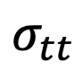
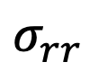
$$u_{r}$$
$$σ_{tt}$$
$$σ_{rr}$$

Slide 3
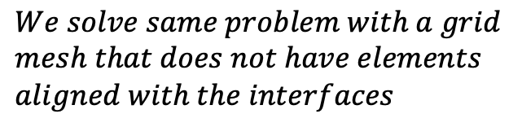

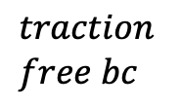
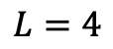
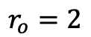
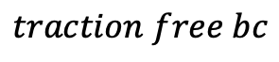

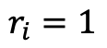
$$traction free bc$$
$$We solve same problem with a grid \\ mesh that does not have elements \\ aligned with the interfaces$$
$$symmetry \\ bc$$
$$E_{3}=2$$
$$p_{ }=0.012 MPa \\ (pressure)$$
$$ν_{3}=0.3$$
$$traction \\ free bc$$
$$E_{2}=1$$
$$ν_{2}=0.3$$
$$E_{1}=1e−3$$
$$ν_{1}=0.3$$
$$symmetry bc$$
$$L=4$$
$$r_{o}=2$$
$$r_{i}=1$$

Slide 4

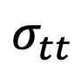
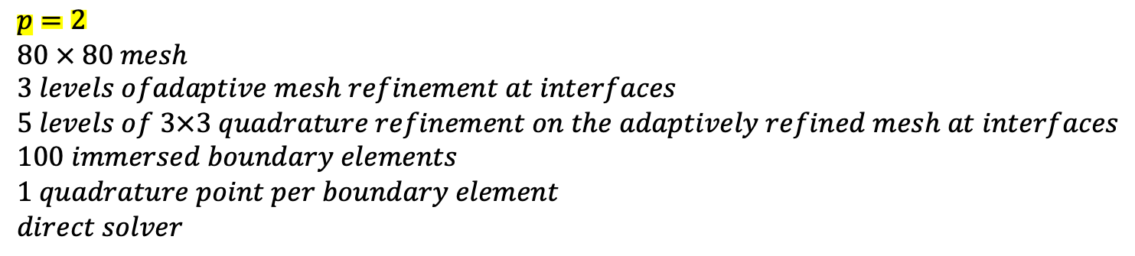
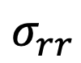
$$p=2 \\ 80 × 80 mesh \\ 3 levels ofadaptive mesh refinement at interfaces \\ 5 levels of 3×3 quadrature refinement on the adaptively refined mesh at interfaces \\ 100 immersed boundary elements \\ 1 quadrature point per boundary element \\ direct solver$$
$$u_{r}$$
$$σ_{tt}$$
$$σ_{rr}$$

Slide 5

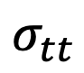
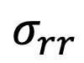
The dashed line is the converged interface aligned solution - we’ll call it “exact”
$$u_{r}$$
$$σ_{tt}$$
$$σ_{rr}$$

Slide 6

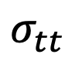
$$p=1 \\ 80 × 80 mesh \\ 3 levels ofadaptive mesh refinement at interfaces \\ 5 levels of 3×3 quadrature refinement on the adaptively refined mesh at interfaces \\ 100 immersed boundary elements \\ 1 quadrature point per boundary element \\ direct solver$$
$$u_{r}$$
$$σ_{tt}$$
$$σ_{rr}$$

Slide 7
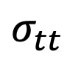
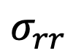

$$u_{r}$$
$$σ_{tt}$$
$$σ_{rr}$$

Slide 8
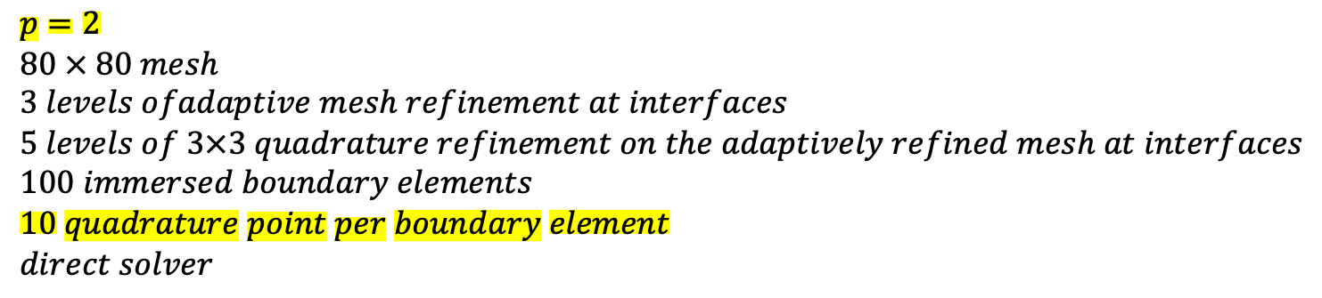
$$p=2 \\ 80 × 80 mesh \\ 3 levels ofadaptive mesh refinement at interfaces \\ 5 levels of 3×3 quadrature refinement on the adaptively refined mesh at interfaces \\ 100 immersed boundary elements \\ 10 quadrature point per boundary element \\ direct solver$$
$$u_{r}$$
$$σ_{tt}$$
$$σ_{rr}$$

